Slide 1
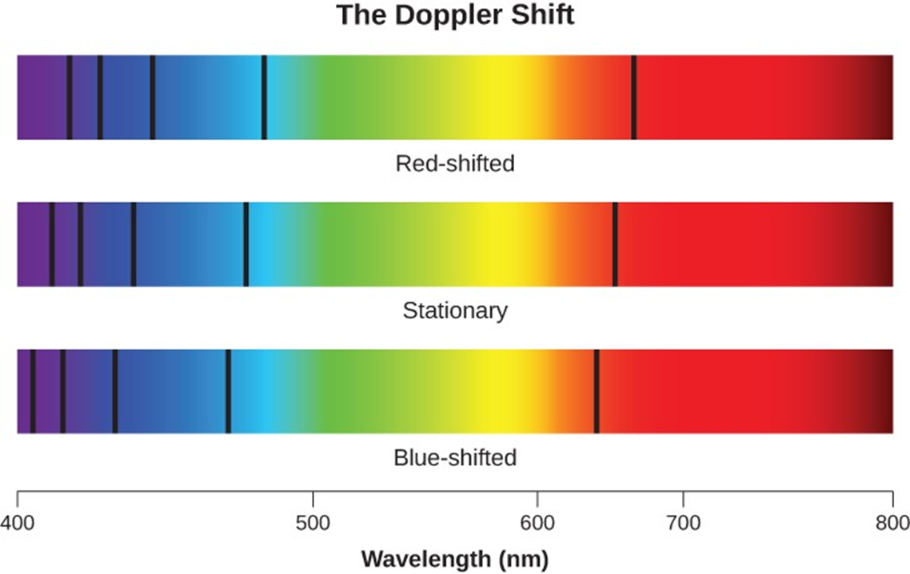
Exploring the Universe
Day 3

Slide 2
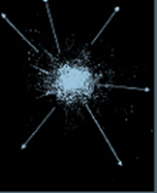
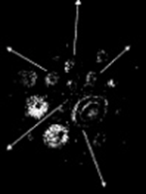
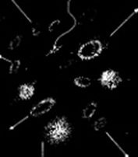
DQ
The following diagrams show stages of the universe’s formation per the Big Bang Theory.
Stage 1
Stage 2
Stage 3
One supporting piece of evidence that strongly supports the Big Bang model is how wavelengths of light from galaxies moving away from our solar system (see stage three above) are observed to be...?
A. longer than normal (red shift)
B. longer than normal (blue shift)
C. shorter than normal (blue shift)
8ESS1.1

Slide 3
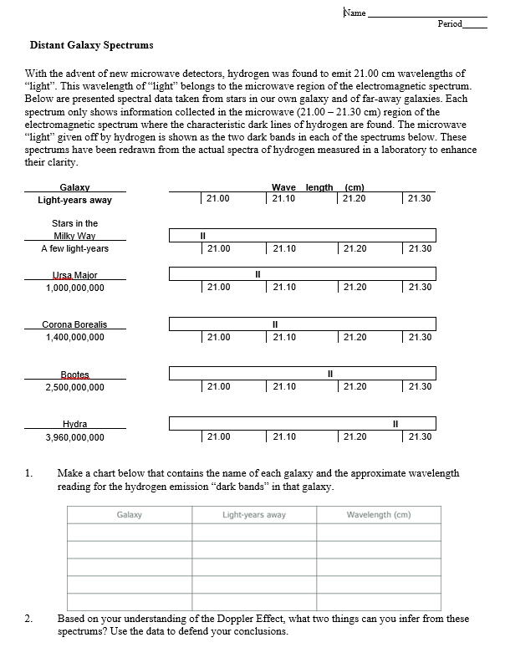
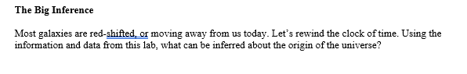
Distant Galaxy Spectrums
Complete this activity on the paper you picked up in class. Don’t forget about the question on the back!
Turn it in when you are finished.
8ESS1.1

Slide 4
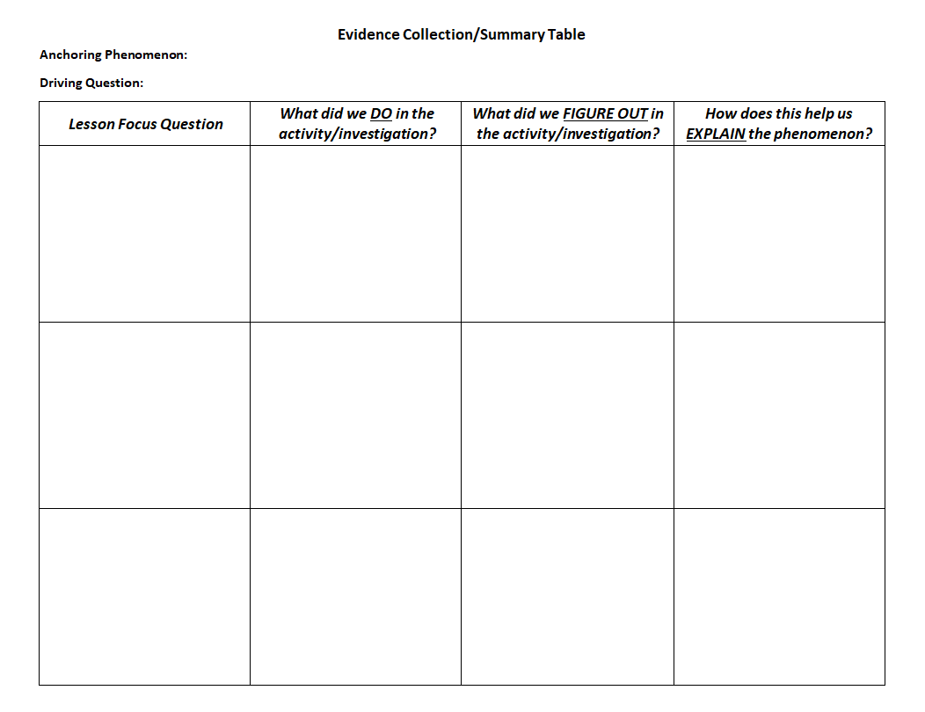
Add this information to the evidence collection summary table.
8ESS1.1

Slide 5
Watch the playposit in TEAMS
8ESS1.1

Slide 6
Revise your initial model
Peer review – Share your final model with your lab table group. Add any information they tell you is missing.
8ESS1.1

